Slide 1
Diophantus
Early 200s

Slide 2
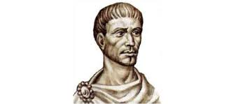
Diophantus
Known as the father of algebra, born in Alexandria, another scholar of the great library
Known for his publishing called Arithmetica, which is a collection of 130 giving solutions for determinate and indeterminate equations
He only examines solutions that were positive and rational, negative and irrational solutions, Diophantus deemed useless

Slide 3
Mathematics with Diophantus
Diophantus examined three types of quadratic equations,
ax^2+bx=c
ax^2=bx+c
ax^2+c=bx
In this time there was no notation for zero, and Diophantus did not deal with negative coefficients.

Slide 4
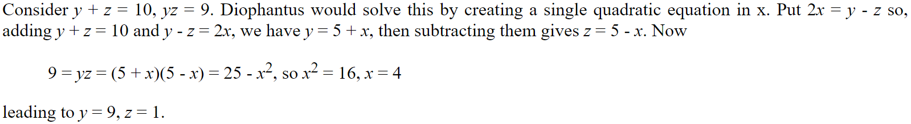
Diophantus also solved problems such as,

Slide 5
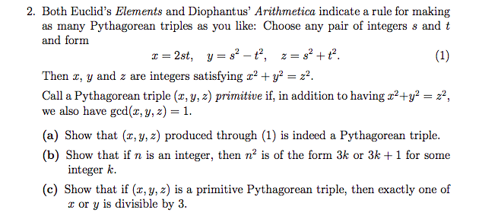
A fun problem from Euclid and Diophantus

Slide 6
Diophantus
Though Diophantus did not use sophisticated algebraic symbolism, he did invent the use of a symbol for the unknown quantity and the powers of the unknown. Therefore taking large steps toward symbolic algebra.
Source for this presentation: http://www-history.mcs.st-andrews.ac.uk/Biographies/Diophantus.html

